Slide 1
The Internet Transport Protocols: TCP
TCP (Transmission Control Protocol) was specifically designed to provide a reliable end-to-end byte stream over an unreliable internetwork.
An internetwork differs from a single network because different parts may have wildly different topologies, bandwidths, delays, packet sizes, and other parameters.
TCP was designed to dynamically adapt to properties of the internetwork and to be robust in the face of many kinds of failures.
TCP was formally defined in RFC 793. As time went on, various errors and inconsistencies were detected, and the requirements were changed in some areas.
These clarifications and some bug fixes are detailed in RFC 1122. Extensions are given in RFC 1323.
Each machine supporting TCP has a TCP transport entity, either a library procedure, a user process, or part of the kernel.

Slide 2
The Internet Transport Protocols: TCP
In all cases, it manages TCP streams and interfaces to the IP layer. A TCP entity accepts user data streams from local processes, breaks them up into pieces not exceeding 64 KB (in practice, often 1460 data bytes in order to fit in a single Ethernet frame with the IP and TCP headers), and sends each piece as a separate IP datagram.
When datagrams containing TCP data arrive at a machine, they are given to the TCP entity, which reconstructs the original byte streams.
For simplicity, we will sometimes use just ''TCP'' to mean the TCP transport entity (a piece of software) or the TCP protocol (a set of rules). From the context it will be clear which is meant.
For example, in ''The user gives TCP the data,'' the TCP transport entity is clearly intended.
The IP layer gives no guarantee that datagrams will be delivered properly, so it is up to TCP to time out and retransmit them.
Datagrams that do arrive may well do so in the wrong order; it is also up to TCP to reassemble them into messages in the proper sequence. TCP must furnish the reliability that most users want and that IP does not provide.

Slide 3
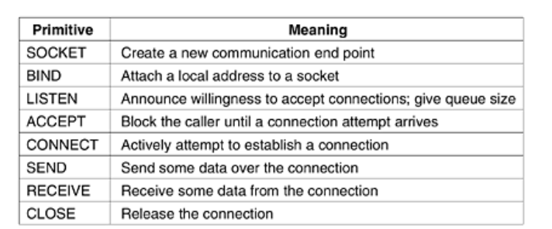
The TCP Service Model
TCP service is obtained by both the sender and receiver creating end points, called sockets. Each socket has a socket number (address) consisting of the IP address of the host and a 16-bit number local to that host, called a port.
A port is the TCP name for a TSAP. For TCP service to be obtained, a connection must be explicitl established between a socket on the sending machine and a socket on the receiving machine.

Slide 4
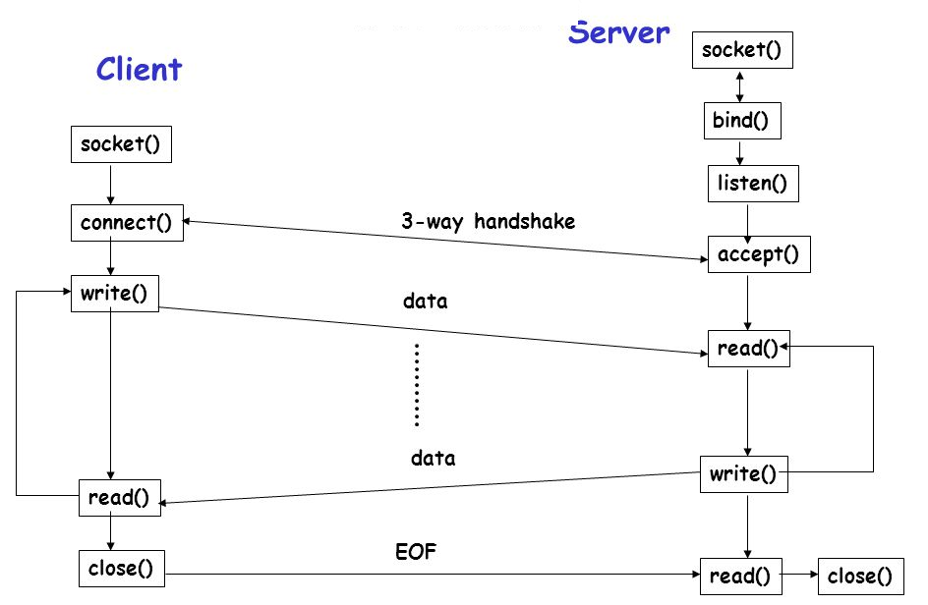
The TCP Service Model

Slide 5
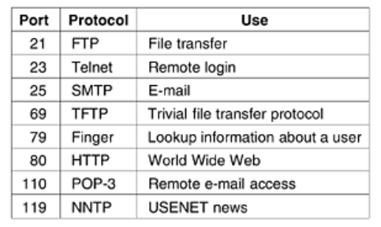
The TCP Service Model
A socket may be used for multiple connections at the same time. In other words, two or more connections may terminate at the same socket. Connections are identified by the socket identifiers at both ends, that is, (socket1, socket2). No virtual circuit numbers or other identifiers are used.
Port numbers below 1024 are called well-known ports and are reserved for standard services. For example, any process wishing to establish a connection to a host to transfer a file using FTP can connect to the destination host's port 21 to contact its FTP daemon.
The list of well-known ports is given at www.iana.org. Over 300 have been assigned. A few of the better known ones are listed.

Slide 6
The TCP Service Model
FTP daemon attach itself to port 21 at boot time, the telnet daemon to attach itself to port 23 at boot time, and so on. However, doing so would clutter up memory with daemons that were idle most of the time.
Instead, what is generally done is to have a single daemon, called inetd (Internet daemon) in UNIX, attach itself to multiple ports and wait for the first incoming connection.
When that occurs, inetd forks off a new process and executes the appropriate daemon in it, letting that daemon handle the request.
In this way, the daemons other than inetd are only active when there is work for them to do. Inetd learns which ports it is to use from a configuration file.
Consequently, the system administrator can set up the system to have permanent daemons on the busiest ports (e.g., port 80) and inetd on the rest.
All TCP connections are full duplex and point-to-point. Full duplex means that traffic can go in both directions at the same time. Point-to-point means that each connection has exactly two end points. TCP does not support multicasting or broadcasting.

Slide 7
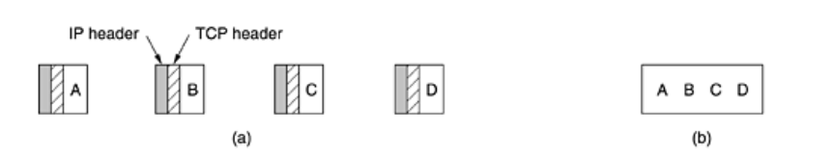
The TCP Service Model
A TCP connection is a byte stream, not a message stream. Message boundaries are not preserved end to end. For example, if the sending process does four 512-byte writes to a TCP stream.
These data may be delivered to the receiving process as four 512-byte chunks, two 1024-byte chunks, one 2048-byte chunk or some other way. There is no way for the receiver to detect the unit(s) in which the data were written.
When an application passes data to TCP, TCP may send it immediately or buffer it (in order to collect a larger amount to send at once), at its discretion.

Slide 8
The TCP Service Model
However, sometimes, the application really wants the data to be sent immediately. For example, suppose a user is logged in to a remote machine.
After a command line has been finished and the carriage return typed, it is essential that the line be shipped off to the remote machine immediately and not buffered until the next line comes in.
To force data out, applications can use the PUSH flag, which tells TCP not to delay the transmission.
Some early applications used the PUSH flag as a kind of marker to delineate messages boundaries.
While this trick sometimes works, it sometimes fails since not all implementations of TCP pass the PUSH flag to the application on the receiving side.
Furthermore, if additional PUSHes come in before the first one has been transmitted (e.g., because the output line is
busy), TCP is free to collect all the PUSHed data into a single IP datagram, with no separation between the various
pieces.

Slide 9
The TCP Service Model
Urgent data - When an interactive user hits the DEL or CTRL-C key to break off a remote computation that has already begun, the sending application puts some control information in the data stream and gives it to TCP along with the URGENT flag.
This event causes TCP to stop accumulating data and transmit everything it has for that connection immediately.
When the urgent data are received at the destination, the receiving application is interrupted (e.g., given a signal in UNIX terms) so it can stop whatever it was doing and read the data stream to find the urgent data.
The end of the urgent data is marked so the application knows when it is over. The start of the urgent data is not marked. It is up to the application to figure that out.
This scheme basically provides a crude signaling mechanism and leaves everything else up to the application.

Slide 10
The TCP Protocol
Every byte on a TCP connection has its own 32-bit sequence number. When the Internet began, the lines between routers were mostly 56-kbps leased lines, so a host blasting away at full speed took over 1 week to cycle through the sequence numbers.
At modern network speeds, the sequence numbers can be consumed at an alarming rate. Separate 32-bit sequence numbers are used for acknowledgements and for the window mechanism.
The sending and receiving TCP entities exchange data in the form of segments. A TCP segment consists of a fixed 20-byte header (plus an optional part) followed by zero or more data bytes.
The TCP software decides how big segments should be. It can accumulate data from several writes into one segment or can split data from one write over multiple segments.
Two limits restrict the segment size. First, each segment, including the TCP header, must fit in the 65,515-byte IP payload. Second, each network has a maximum transfer unit, or MTU, and each segment must fit in the MTU.

Slide 11
The TCP Protocol
The MTU is generally 1500 bytes (the Ethernet payload size) and thus defines the upper bound on segment size.
The basic protocol used by TCP entities is the sliding window protocol. When a sender transmits a segment, it also starts a timer.
When the segment arrives at the destination, the receiving TCP entity sends back a segment (with data if any exist, otherwise without data) bearing an acknowledgement number equal to the next sequence number it expects to receive.
If the sender's timer goes off before the acknowledgement is received, the sender transmits the segment again.
Segments can also be delayed so long in transit that the sender times out and retransmits them.
The retransmissions may include different byte ranges than the original transmission, requiring a careful administration to keep track of which bytes have been correctly received so far.

Slide 12
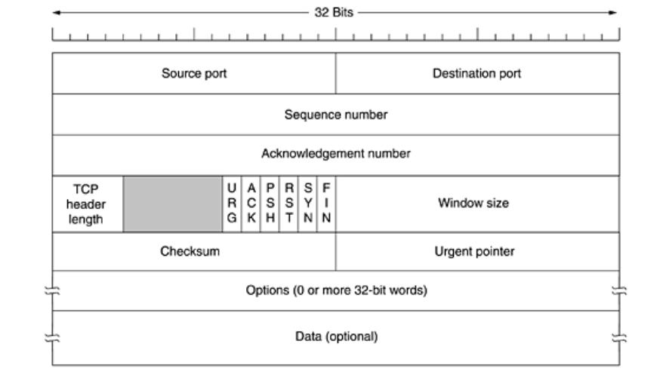
The TCP Segment Header
Every segment begins with a fixed-format, 20-byte header. The fixed header may be followed by header options.
After the options, if any, up to 65,535 - 20 - 20 = 65,495 data bytes may follow, where the first 20 refer to the IP header and the second to the TCP header.
Segments without any data are legal and are commonly used for acknowledgements and control messages.

Slide 13
The TCP Segment Header
The Source port and Destination port fields identify the local end points of the connection.
A port plus its host's IP address forms a 48-bit unique end point. The source and destination end points together identify the connection.
The Sequence number and Acknowledgement number fields perform their usual functions. Note that the latter specifies the next byte expected, not the last byte correctly received. Both are 32 bits long because every byte of data is numbered in a TCP stream.
The TCP header length tells how many 32-bit words are contained in the TCP header. This information is needed because the Options field is of variable length, so the header is, too.
Technically, this field really indicates the start of the data within the segment, measured in 32-bit words, but that number is just the header length in words, so the effect is the same.
Next comes a 6-bit field that is not used. The fact that this field has survived intact for over a quarter of a century is testimony to how well thought out TCP is. Lesser protocols would have needed it to fix bugs in the original design.

Slide 14
The TCP Segment Header
Six 1-bit flags. URG is set to 1 if the Urgent pointer is in use. The Urgent pointer is used to indicate a byte offset from the current sequence number at which urgent data are to be found. This facility is in lieu of interrupt messages.
The ACK bit is set to 1 to indicate that the Acknowledgement number is valid. If ACK is 0, the segment does not contain an acknowledgement so the Acknowledgement number field is ignored.
The PSH bit indicates PUSHed data. The receiver is hereby kindly requested to deliver the data to the application upon arrival and not buffer it until a full buffer has been received (which it might otherwise do for efficiency).
The RST bit is used to reset a connection that has become confused due to a host crash or some other reason. It is also used to reject an invalid segment or refuse an attempt to open a connection.
The SYN bit is used to establish connections. The connection request has SYN = 1 and ACK = 0 to indicate that the piggyback acknowledgement field is not in use.
The connection reply does bear an acknowledgement, so it has SYN = 1 and ACK = 1. In essence the SYN bit is used to denote CONNECTION REQUEST and CONNECTION ACCEPTED, with the ACK bit used to distinguish between those two possibilities.

Slide 15
The TCP Segment Header
The FIN bit is used to release a connection. It specifies that the sender has no more data to transmit. However, after closing a connection, the closing process may continue to receive data indefinitely. Both SYN and FIN segments have sequence numbers and are thus guaranteed to be processed in the correct order.
Flow control in TCP is handled using a variable-sized sliding window. The Window size field tells how many bytes may be sent starting at the byte acknowledged.
A Window size field of 0 is legal and says that the bytes up to and including Acknowledgement number - 1 have been received, but that the receiver is currently badly in need of a rest and would like no more data for the moment, thank you.
The receiver can later grant permission to send by transmitting a segment with the same Acknowledgement number and a nonzero Window size field.
A Checksum is also provided for extra reliability. It checksums the header, the data, and the conceptual pseudoheader. When performing this computation, the TCP Checksum field is set to zero and the data field is padded out with an additional zero byte if its length is an odd number.

Slide 16
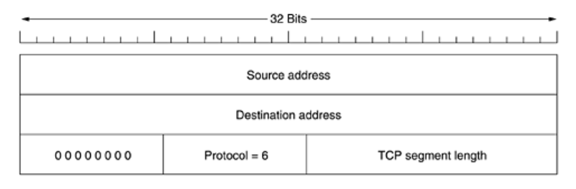
The TCP Segment Header
The checksum algorithm is simply to add up all the 16-bit words in one's complement and then to take the one's complement of the sum. As a consequence, when the receiver performs the calculation on the entire segment, including the Checksum field, the result should be 0.
The pseudoheader contains the 32-bit IP addresses of the source and destination machines, the protocol number for TCP (6), and the byte count for the TCP segment (including the header).
Including the pseudoheader in the TCP checksum computation helps detect misdelivered packets, but including it also violates the protocol hierarchy since the IP addresses in it belong to the IP layer, not to the TCP layer. UDP uses the same pseudoheader for its checksum.

Slide 17
The TCP Segment Header
The Options field provides a way to add extra facilities not covered by the regular header. The most important option is the one that allows each host to specify the maximum TCP payload it is willing to accept.
Using large segments is more efficient than using small ones because the 20-byte header can then be amortized over more data, but small hosts may not be able to handle big segments.
During connection setup, each side can announce its maximum and see its partner's. If a host does not use this option, it defaults to a 536-byte payload.
All Internet hosts are required to accept TCP segments of 536 + 20 = 556 bytes. The maximum segment size in the two directions need not be the same.
For lines with high bandwidth, high delay, or both, the 64-KB window is often a problem. On a T3 line (44.736 Mbps), it takes only 12 msec to output a full 64-KB window.
If the round-trip propagation delay is 50 msec (which is typical for a transcontinental fiber), the sender will be idle 3/4 of the time waiting for acknowledgements. On a satellite connection, the situation is even worse.

Slide 18
The TCP Segment Header
A larger window size would allow the sender to keep pumping data out, but using the 16-bit Window size field, there is no way to express such a size.
This number allows both sides to shift the Window size field up to 14 bits to the left, thus allowing windows of up to 230 bytes. Most TCP implementations now support this option.
If the receiver gets one bad segment and then a large number of good ones, the normal TCP protocol will eventually time out and retransmit all the unacknowledged segments, including all those that were received correctly (i.e., the go back n protocol).
After it gets these, it can acknowledge all the buffered data, thus reducing the amount of data retransmitted.

